Slide 1
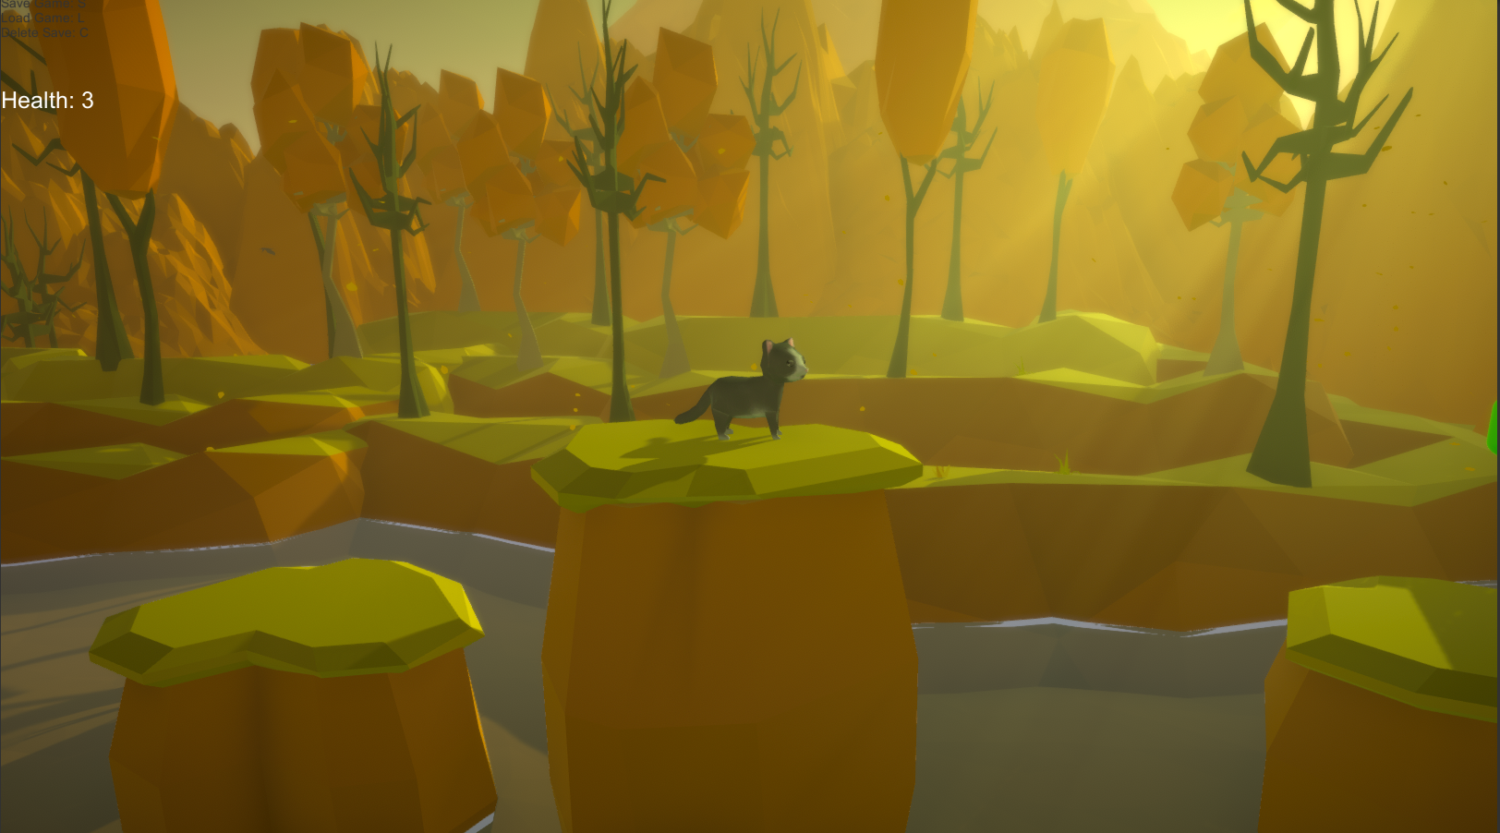
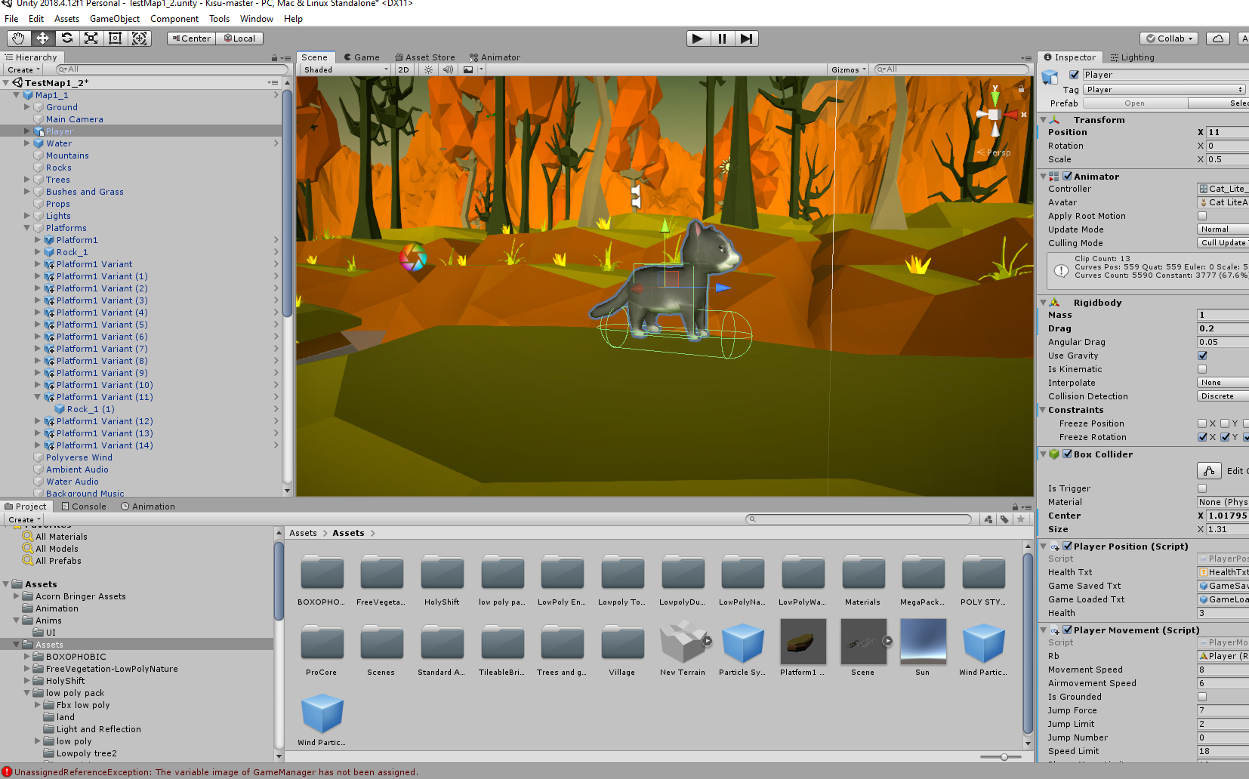
Catventures – a Unity game project
Arttu Mäkelä, Ville Lipsanen, Jouni Peltola
Information Technology, Software Engineering
Introduction
Catventures is a 2.5D platformer game made with Unity, where the player controls a cat lost in nature. The goal of the player is to try find a way home while avoiding the dangers on the way. The cat has simple movement functions consisting of left and right movement, jump and double jump abilities and a dash ability.
FIGURE 1. The general look of the game
The map is balanced around the player using these abilities accordingly but game difficulty is kept fairly easy so that even young kids can play it. The goal for us in the project was to learn C# through writing scripts and overall learn how simpler games are made with Unity. As usual with working in a project, we also gained further experience working in project environments.
Methods
The game was developed with Unity3D editor and the scripts were written with C# using Microsoft Visual Studio 2017. Project scheduling and delegating tasks was done using Trello. Project meetings were scheduled weekly and online using Microsoft Teams. Since we lacked the facilities to develop the game in school, we needed to work on our own PCs at home. This made problem solving sometimes more challenging. Github was used for version control.
FIGURE 2. Unity3D Editor
Results
Project goals were achieved for the most part. The game looks good and controlling the character is fluid and responsive. Saving system works well and can be expanded upon easily if game is developed further. Gameplay mechanics and length of map are lacking, since we used most of our time developing the base game rather than expanding the map.
Conclusions
Project was challenging to get started since most of us had no prior experience with Unity. We learned a lot about how games work under the hood and what is required to develop a playable game. Gaming was an interesting topic and a hobby for most of us, which made learning coding through the project more enjoyable than usual.
References
https://www.youtube.com/user/Brackeys
https://docs.unity3d.com/Manual/index.html
Project Course
Date of publication: 2019, December
Supervisor Pertti Heikkilä

